Slide 1
CC5212-1 Procesamiento Masivo de Datos Otoño 2016 Lecture 7: Information Retrieval I
Aidan Hogan
aidhog@gmail.com

Slide 2
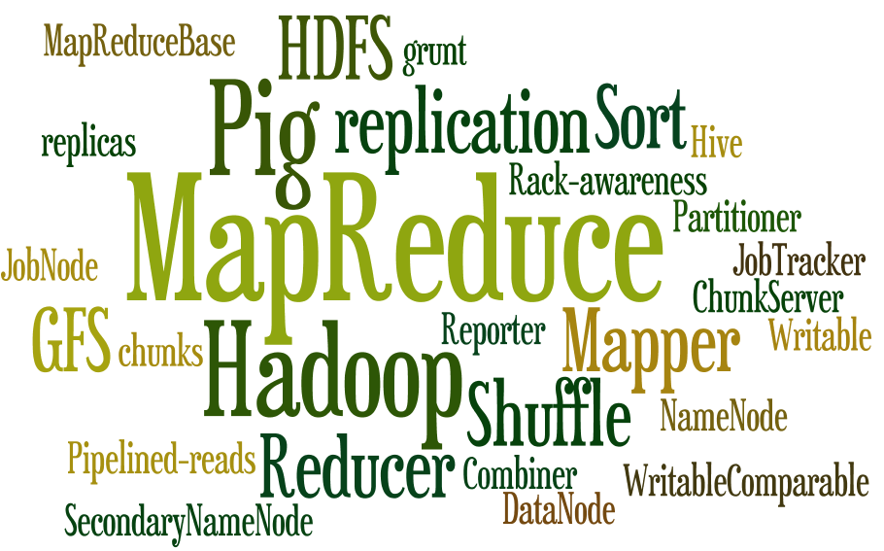

Slide 3

MANAGING TEXT data

Slide 4
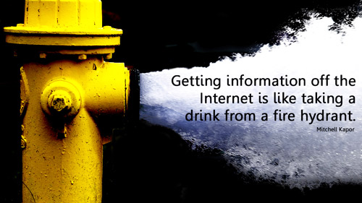
Information Overload

Slide 5

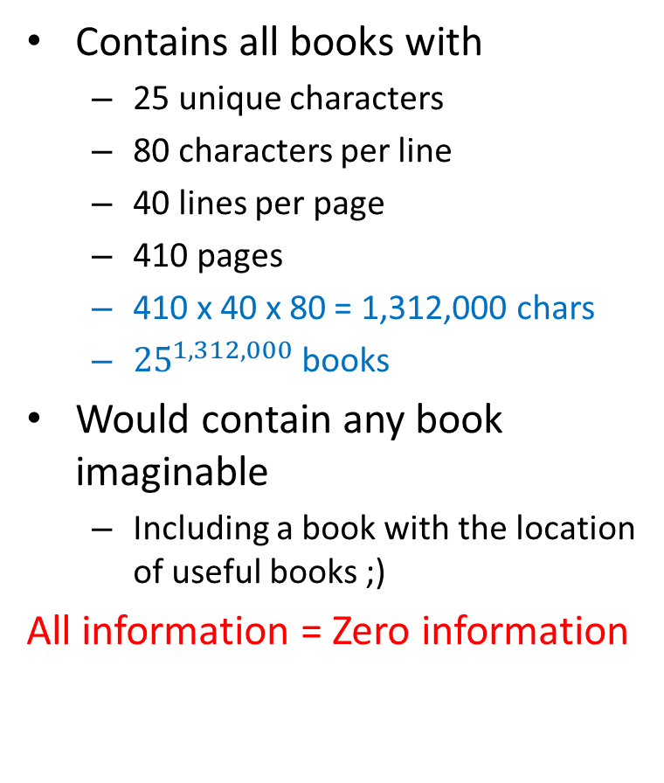
If we didn’t have search …
Contains all books with
25 unique characters
80 characters per line
40 lines per page
410 pages
410 x 40 x 80 = 1,312,000 chars
${25}^{1,312,000}$ books
Would contain any book imaginable
Including a book with the location of useful books ;)
All information = Zero information

Slide 6
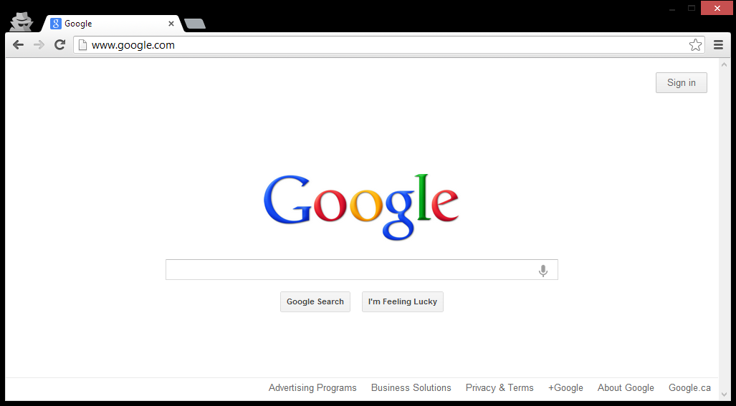
The book that indexes the library

Slide 7
SEARCH, QUERY, RETRIEVAL

Slide 8
Search, Query & Retrieval
Search: the goal/aim of the user
Query: the expression of a search
Retrieval: the machine method to “solve” a query
… roughly speaking

Slide 9
Retrieval
Machine has a bunch of information resources of some sort (let’s call it a set I)
e.g., documents, movie pages, actor descriptions
A user search wants to find some subset of I
e.g., Irish actors, documents about Hadoop
User expresses search criteria as a query Q
e.g., “irish actors”, “hadoop”, “SELECT ?movie …”
Retrieval engine returns results: R is a minimal subset of I relevant to Q
Results R may be ordered by a ranking
e.g., by most famous Irish actors

Slide 10

Data Retrieval
Retrieval over “structured data”
Typical of databases
I is a dataset, e.g., a set of relations
Q is a structured query, e.g., SQL
R is a list of tuples, possibly ordered
SELECT * FROM actor WHERE country = “Ireland” ORDER BY earnings;

Slide 11
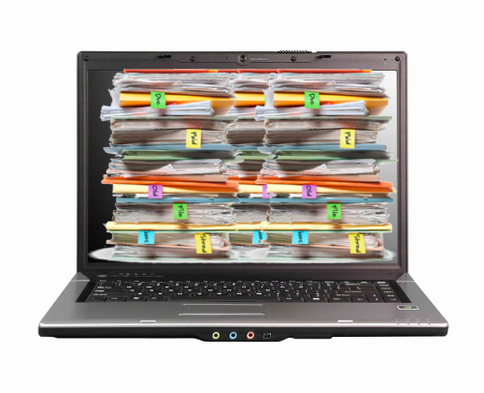
Information Retrieval
Retrieval over “unstructured data” or textual data
Typical of web search
I is a set of text documents, e.g., web pages
Q is a keyword query
R is a list of documents, e.g., relevant pages
“most famous Irish actors”

Slide 12
WEB SEARCH/RETRIEVAL

Slide 13
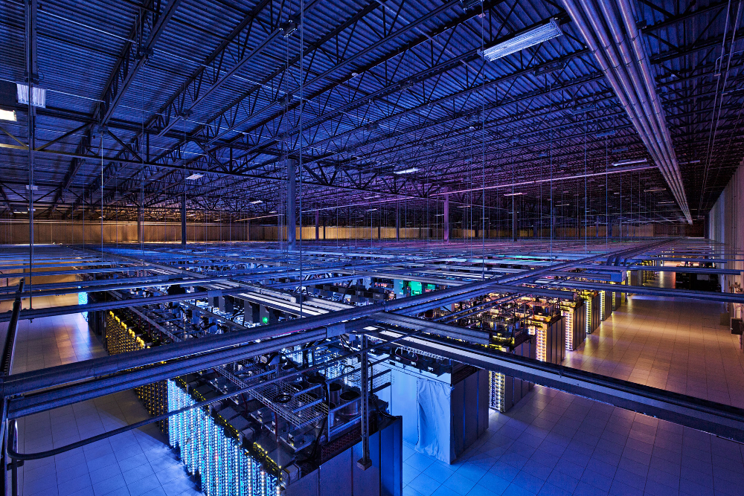
Inside Google

Slide 14
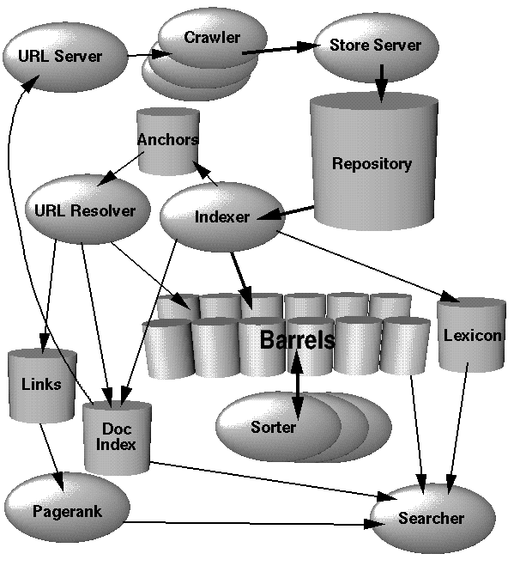
Google Architecture (ca. 1998)
Information Retrieval
Crawling
Inverted indexing
PageRank

Slide 15
INFORMATION RETRIEVAL: CRAWLING

Slide 16
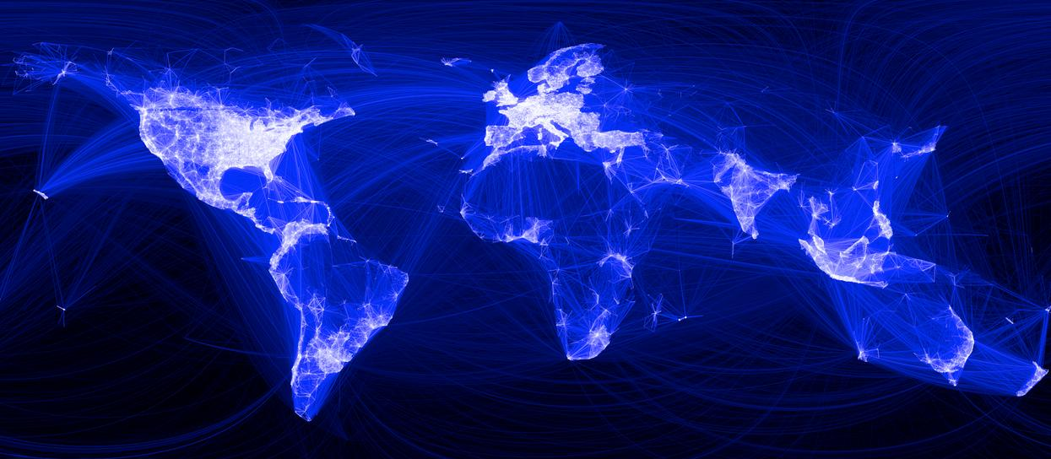
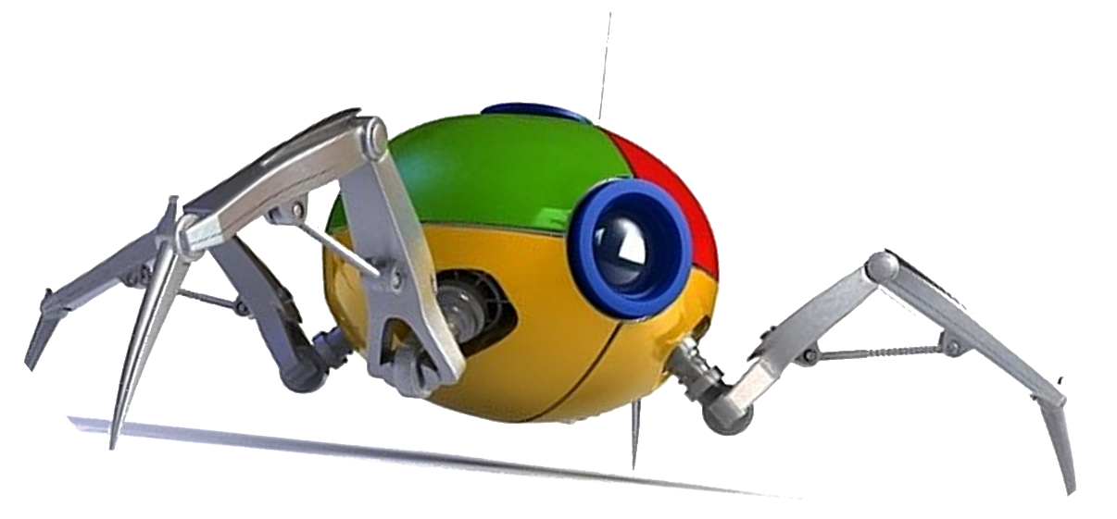
How does Google know about the Web?

Slide 17
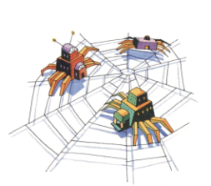
Crawling
Download the Web. ☺
crawl(list seedUrls)
frontier_i = seedUrls
while(!frontier_i .isEmpty())
new list frontier_i+1
for url : frontier_i
page = downloadPage(url)
frontier_i+1.addAll(extractUrls(page))
store(page)
i++
What’s missing from this code?

Slide 18
Crawling: Avoid Cycles
Download the Web. ☺
crawl(list seedUrls)
frontier_i = seedUrls
new set urlsSeen
while(!frontier_i .isEmpty())
new list frontier_i+1
for url : frontier_i
page = downloadPage(url)
urlsSeen.add(url)
frontier_i+1.addAll(extractUrls(page).removeAll(urlsSeen))
store(page)
i++
What about the performance of this code?

Slide 19
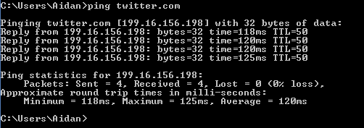
Crawling: Catering for Slow Network
page = downloadPage(url)
Majority of the time spent will be spent waiting for connection
Disk and CPU of crawling machine barely occupied
Bandwidth will not be maximised (stop / start)

Slide 20
Crawling: Multi-threading Important
crawl(list seedUrls)
frontier_i = seedUrls
new set urlsSeen
while(!frontier_i .isEmpty())
new list frontier_i+1
new list threads
for url : frontier_i
thread = new DownloadPageThread.run(url,urlsSeen,fronter_i+1)
threads.add(thread)
threads.poll()
i++
DownloadPageThread: run(url,urlsSeen,frontier_i+1)
page = downloadPage(url)
synchronised: urlsSeen.add(url)
synchronised: frontier_i+1.addAll(extractUrls(page).removeAll(urlsSeen))
synchronised: store(page)

Slide 21
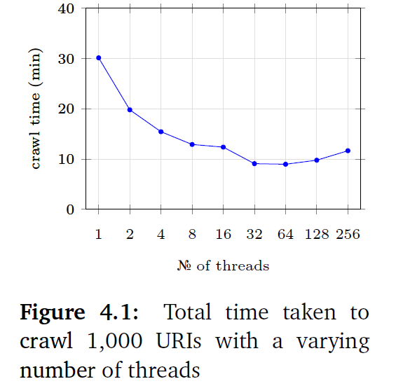
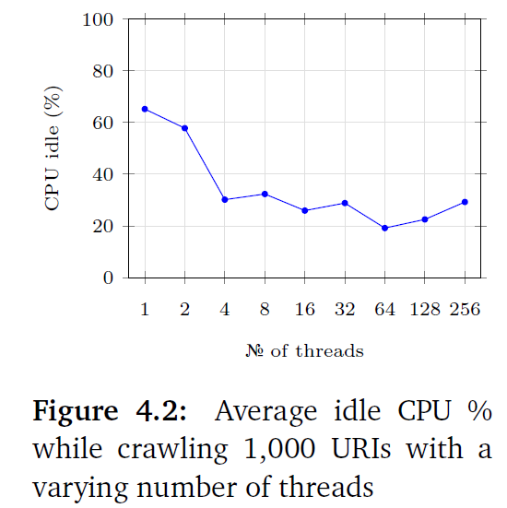
Crawling: Multi-threading Important

Slide 22
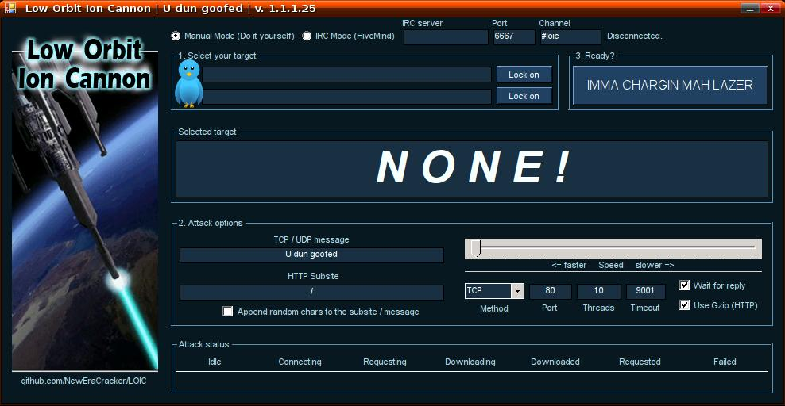
Crawling: Important to be Polite!
(Distributed) Denial of Server Attack: (D)DoS

Slide 23
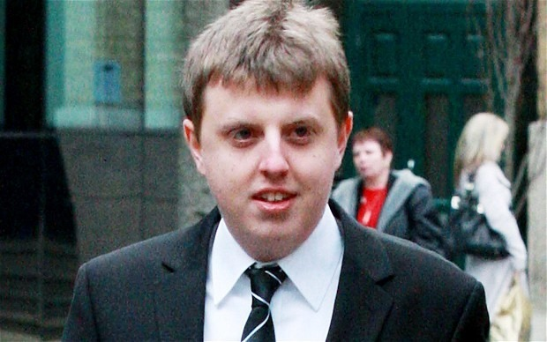
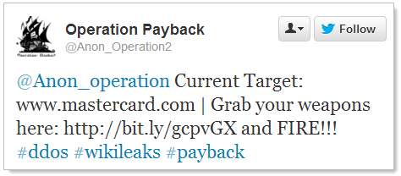
Crawling: Avoid (D)DoSing
But more likely your IP range will be banned by the web-site (DoS attack)
Christopher Weatherhead
Imprisoned for 18 months!

Slide 24
Crawling: Web-site Scheduler
crawl(list seedUrls)
frontier_i = seedUrls
new set urlsSeen
while(!frontier_i .isEmpty())
new list frontier_i+1
new list threads
for url : schedule(frontier_i) #maximise time between two pages on one site
thread = new DownloadPageThread.run(url,urlsSeen,fronter_i+1)
threads.add(thread)
threads.poll()
i++
DownloadPageThread: run(url,urlsSeen,frontier_i+1)
page = downloadPage(url)
synchronised: urlsSeen.add(url)
synchronised: frontier_i+1.addAll(extractUrls(page) .removeAll(urlsSeen))
synchronised: store(page)

Slide 25
Robots Exclusion Protocol
http://website.com/robots.txt
User-agent: *
Disallow: /
No bots allowed on the website.
User-agent: *
Disallow: /user/
Disallow: /main/login.html
No bots allowed in /user/ sub-folder or login page.
User-agent: googlebot
Disallow: /
Ban only the bot with “user-agent” googlebot.

Slide 26
Robots Exclusion Protocol (non-standard)
User-agent: googlebot
Crawl-delay: 10
Tell the googlebot to only crawl a page from this host no more than once every 10 seconds.
User-agent: *
Disallow: /
Allow: /public/
Ban everything but the /public/ folder for all agents
User-agent: *
Sitemap: http://example.com/main/sitemap.xml
Tell user-agents about your site-map

Slide 27
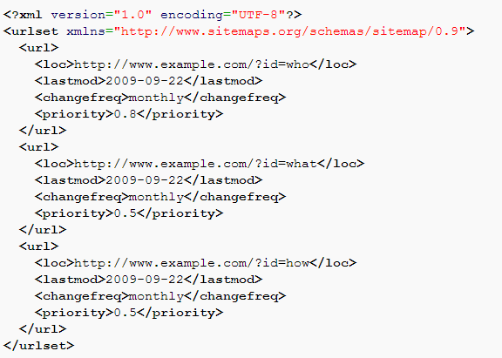
Site-Map

Slide 28
Crawling: Important Points
Seed-list: Entry point for crawling
Frontier: Extract links from current pages for next round
Threading: Keep machines busy; mitigate waits for connection
Seen-list: Avoid cycles
Politeness: Don’t annoy web-sites
Set a politeness delay between crawling pages on the same web-site
Stick to what’s stated in the robots.txt file
Check for a site-map

Slide 29

Crawling: Distribution
Similar benefits to multi-threading
Local frontier and seen-URL list!
How might we implement a distributed crawler?
for url : frontier_i-1
map(url,count)
1
2
3
4
5
What will be the bottleneck as machines increase?

Slide 30
Crawling: Other Options
Breadth-first: As per the pseudo-code, crawl in rounds
Extract one-hop from seed URLs …
Extract n-hop from seed URLs
Depth-first: Follow first link in first page, first link in second page, etc.
Best/topic-first: Rank the URLs according to topic, number of in-links, etc.
Hybrid: A mix of strategies
Possible advantages of breadth vs. depth first?

Slide 31
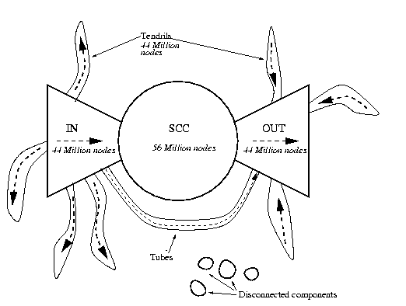
Crawling: Inaccessible (Bow-Tie)
A. Broder, R. Kumar, F. Maghoul, P. Raghavan, S. Rajagopalan, R. Stata, A. Tomkins, and J. Wiener, “Graph structure in the web,” Comput. Networks, vol. 33, no. 1-6, pp. 309–320, 2000

Slide 32
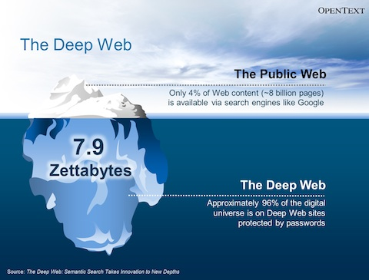
Crawling: Inaccessible (Deep-Web)
Deep-web:
Dynamically-generated content
Password protected / firewalled
Dark Web
Remember: 46% of statistics are made up on the spot. ☺
Image from http://www.legaltechnology.com/wp-content/uploads/2013/07/OpenText-EIM-Summary.pdf

Slide 33


Apache Nuche
Open-source crawling framework!
Compatible with Hadoop!
https://nutch.apache.org/

Slide 34
INFORMATION RETRIEVAL: INVERTED-INDEXING

Slide 35
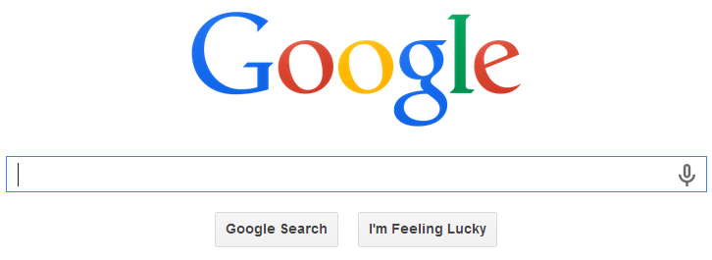

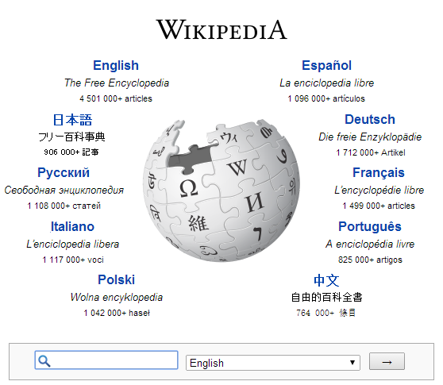

Inverted Index
Inverted Index: A map from words to documents
“Inverted” because usually documents map to words
At the core of all keyword search applications

Slide 36

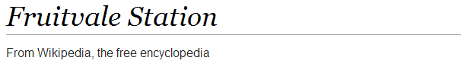
Inverted Index: Example
1
1 10 18 21 23 28 37 43 47 55 59 68 71 76
Fruitvale Station is a 2013 American drama film written and directed by Ryan Coogler.
Term List | Posting Lists
a | (1,[21,96,103,…]), (2,[…]), …
american | (1,[28,123]), (5,[…]), …
and | (1,[57,139,…]), (2,[…]), …
by | (1,[70,157,…]), (2,[…]), …
directed | (1,[61,212,…]), (4,[…]), …
drama | (1,[38,87,…]), (16,[…]), …
… | …
Inverted index:

Slide 37
Inverted Index: Example Search
american drama
AND: Posting lists intersected (optimised!)
OR: Posting lists unioned
PHRASE: AND + check locations
Word | Posting Lists
a | (1,[21,96,103,…]), (2,[…]), …
american | (1,[28,123]), (5,[…]), …
and | (1,[57,139,…]), (2,[…]), …
by | (1,[70,157,…]), (2,[…]), …
directed | (1,[61,212,…]), (4,[…]), …
drama | (1,[38,87,…]), (16,[…]), …
… | …
Inverted index:

Slide 38
Inverted Index Flavours
Record-level inverted index: Maps words to documents without positional information
Word-level inverted index: Additionally maps words with positional information

Slide 39
Inverted Index: Word Normalisation
drama america
Word normalisation: grammar removal, case, lemmatisation, accents, etc.
Query side and/or index side
Term List | Posting Lists
a | (1,[21,96,103,…]), (2,[…]), …
american | (1,[28,123]), (5,[…]), …
and | (1,[57,139,…]), (2,[…]), …
by | (1,[70,157,…]), (2,[…]), …
directed | (1,[61,212,…]), (4,[…]), …
drama | (1,[38,87,…]), (16,[…]), …
… | …
Inverted index:

Slide 40
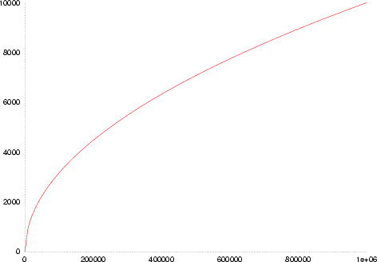
Inverted Index: Space
Not so many unique words …
but lots of new proper nouns
Heap’s law:
UW(n) ≈ Kn^{β}
English text
K ≈ 10
β ≈ 0.6
Number of unique words in text
Number of words in text

Slide 41
Inverted Index: Space
As text size grows in a given document
(n words) …
Unique words (i.e., inverted index keys) grow sub-linearly: O(n^{β}) for β ≈ 0.6
Positions of occurrence grow linearly O(n)

Slide 42
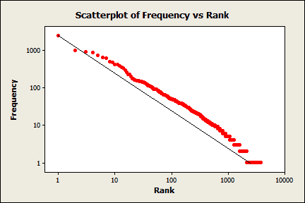
Inverted Index: Common Words
Many occurrences of few words
Few occurrences of many words
Zipf’s law
In English text:
“the” 7%
“of” 3.5%
“and” 2.7%
135 words cover half of all occurrences
Zipf’s law: the most popular word will occur twice as often as the second most popular word, thrice as often as the third most popular word, n times as often as the n-most popular word.

Slide 43
Inverted Index: Common Words
Expect long posting lists for common words
Also expect more queries for common words

Slide 44
Inverted Index: Common Words
Perhaps implement stop-words?
Most common words contain least information
Perhaps implement block-addressing?
the drama in america
Fruitvale Station is a 2013 American drama film written and directed by Ryan Coogler.
Block 1
Block 2
Term List | Posting Lists
a | (1,[1,…]), (2,[…]), …
american | (1,[1,…]), (5,[…]), …
and | (1,[2, …]), (2,[…]), …
by | (1,[2, …]), (2,[…]), …
… | …
What is the effect on phrase search?

Slide 45
Search Implementation
Vocabulary keys:
Hashing: O(1) lookups (assuming good hashing)
no range queries
relatively easy to update (though rehashing expensive!)
Sorting/B-Tree: O(log(u)) lookups, u unique words
range queries
tricky to update (standard methods for B-trees)
Tries: O(l) lookups, l length of the word
range queries, compressed, auto-completion!
referencing becomes tricky (esp. on disk)

Slide 46
Memory Sizes
Vocabulary keys:
Often will fit in memory!
Posting lists may be kept on disk
(hot regions cached)

Slide 47
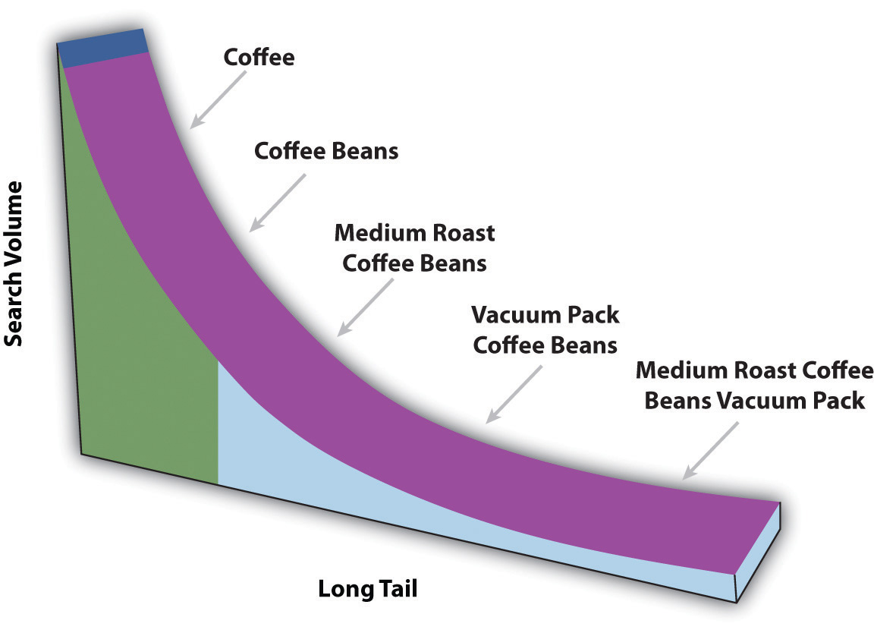
The Long Tail
What would this mean for a cache?

Slide 48
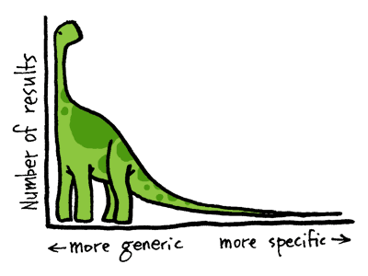
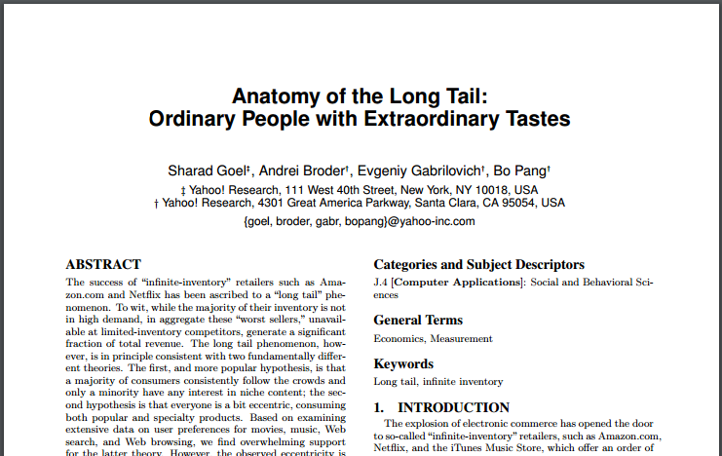
If interested in long tails …

Slide 49
Compression techniques
Numeric compression important
Term List | Posting Lists
country | (1), (2), (3), (4), (6), (7), …
… | …

Slide 50
Compression techniques: High Level
Interval indexing
Example for record-level indexing
Could also be applied for block-level indexing, etc.
Term List | Posting Lists
country | (1), (2), (3), (4), (6), (7), …
… | …
Term List | Posting Lists
country | (1–4), (6–7),
… | …

Slide 51
Compression techniques: High Level
Gap indexing
Example for record-level indexing
Could also be applied for block-level indexing, etc.
Term List | Posting Lists
country | (1), (3), (4), (8), (9), …
… | …
Term List | Posting Lists
country | (1), 2, 1, 4, 1
… | …
What’s the benefit?
Repeated small numbers easier to compress

Slide 52
Compression techniques: Bit Level
Variable length coding: bit-level techniques
For example, Elias γ (gamma) encoding
Assumes many small numbers
z: integer to encode | n = ⌊log₂(z)⌋ coded in unary | a zero marker | next n binary numbers | final Elias γ code
1 | 0 |  |  | 0
2 | 1 | 0 | 0 | 100
3 | 1 | 0 | 1 | 101
4 | 11 | 0 | 00 | 11000
5 | 11 | 0 | 01 | 11001
6 | 11 | 0 | 10 | 11010
7 | 11 | 0 | 11 | 11011
8 | 111 | 0 | 000 | 1110000
… | … | … | … | …
Can you decode “01000011000111000011001”?
<1,2,1,1,4,8,5>

Slide 53
Compression techniques: Bit Level
Variable length coding: bit-level techniques
For example, Elias δ (delta) encoding
Better for some distributions
z: integer to encode | n = ⌊log₂(z)⌋ coded in Elias γ | next n binary numbers | final Elias δ code
1 | 0 |  | 0
2 | 100 | 0 | 1000
3 | 100 | 1 | 1001
4 | 101 | 00 | 10100
5 | 101 | 01 | 10101
6 | 101 | 10 | 10110
7 | 101 | 11 | 10111
8 | 11000 | 000 | 11000000
… | … | … | …
Can you decode “0110000011001011001001”?
<1,9,3,1,17>

Slide 54
Compression techniques: Byte Level
Use variable length byte codes
Use last bit of byte to indicate if the number ends
For example:
0010010 = 18, 1010001= 81, 100010010= 274
00100100
10100010
00000101
00100100

Slide 55
Parametric compression
Previous methods “non-parametric”
Don’t take an input value
Other compression techniques parametric:
for example, Golomb-3 code:
z: integer to encode | n = ⌊(z-1)/3⌋ coded in unary | binary remainder | final Golomb-3 code
1 | 0 | 0 | 00
2 | 0 | 10 | 010
3 | 0 | 11 | 011
4 | 1 | 0 | 100
5 | 1 | 10 | 1010
6 | 1 | 11 | 1011
7 | 11 | 00 | 1100
8 | 11 | 010 | 11010
… | … | … | …

Slide 56
Other Optimisations
Top-Doc: Order posting lists to give likely “top documents” first: good for top-k results
Selectivity: Load the posting lists for the most rare keywords first; apply thresholds
Sharding: Distribute an index over multiple machines
How might an inverted index be split over multiple machines?

Slide 57
Extremely Scalable/Efficient
When engineered correctly ☺

Slide 58
AN INVERTED INDEX SOLUTION

Slide 59

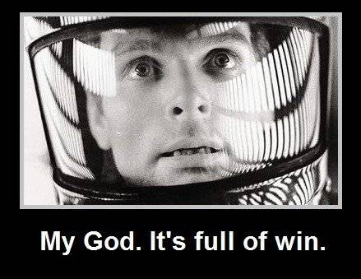
Apache Lucene
Inverted Index
They built one so you don’t have to!
Open Source in Java

Slide 60

(Apache Solr)
Built on top of Apache Lucene
Lucene is the inverted index
Solr is a distributed search platform, with distribution, fault tolerance, etc.
(We will work with Lucene)

Slide 61
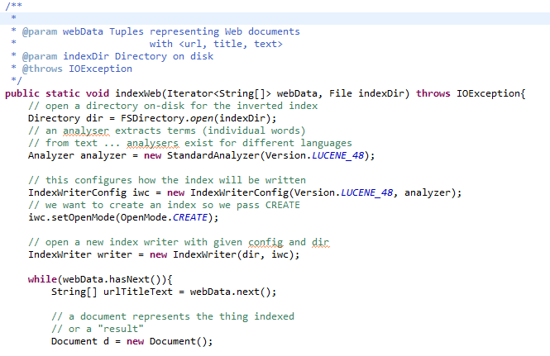
Apache Lucene: Indexing Documents
… continued …

Slide 62
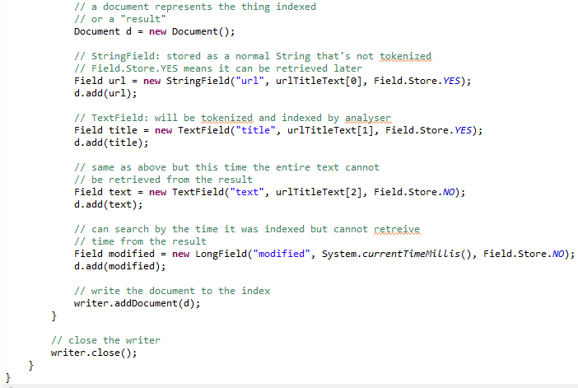
Apache Lucene: Indexing Documents
… continued …

Slide 63
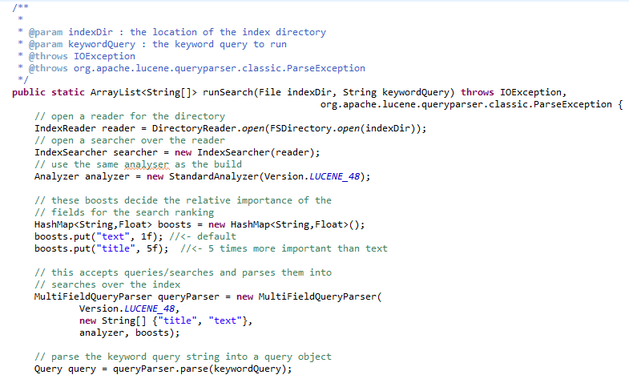
Apache Lucene: Searching Documents

Slide 64
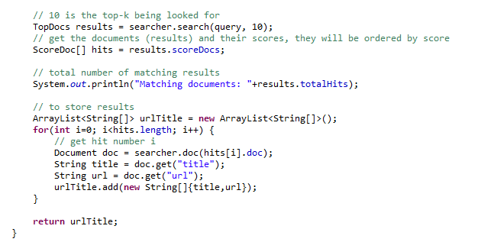
Apache Lucene: Searching Documents

Slide 65
RECAP

Slide 66
Recap
Information overload in Big Data
Search: user intent
Query: user expression of search
Retrieval: machine methods to execute search

Slide 67
Recap
Crawling:
Avoid cycles, multi-threading, politeness, DDoS, robots exclusion, sitemaps, distribution, breadth-first, topical crawlers, deep web
Inverted Indexing:
boolean queries, record-level vs. word-level vs. block-level, word normalisation, lemmatisation, space, Heap’s law, Zipf’s law, stop-words, tries, hashing, long tail, compression, interval coding, variable length encoding, Elias encoding, top doc, sharding, selectivity

Slide 68
CLASS PROJECTS

Slide 69
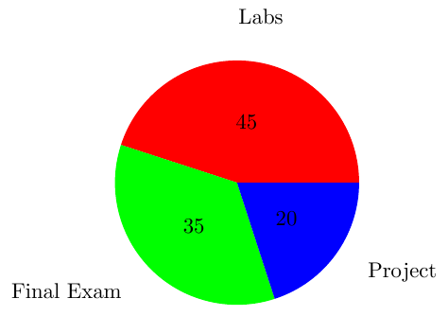
Course Marking
45% for Weekly Labs (~3% a lab!)
35% for Final Exam
20% for Small Class Project

Slide 70
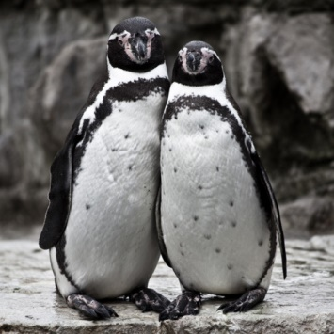
Class Project
Done in pairs (typically …)
Goal: Use what you’ve learned to do something cool/fun (hopefully)
Expected difficulty: A bit more than a lab’s worth
But without guidance (can extend lab code)
Marked on: Difficulty, appropriateness, scale, good use of techniques, presentation, coolness, creativity, value
Ambition is appreciated, even if you don’t succeed: feel free to bite off more than you can chew! I will take this into account.
Process:
Pair up (default random) by next Wednesday’s lab (May 4th)
Start thinking up topics
If you need data or get stuck, I will (try to) help out
Deliverables: 5/7 minute presentation & short report

Slide 71
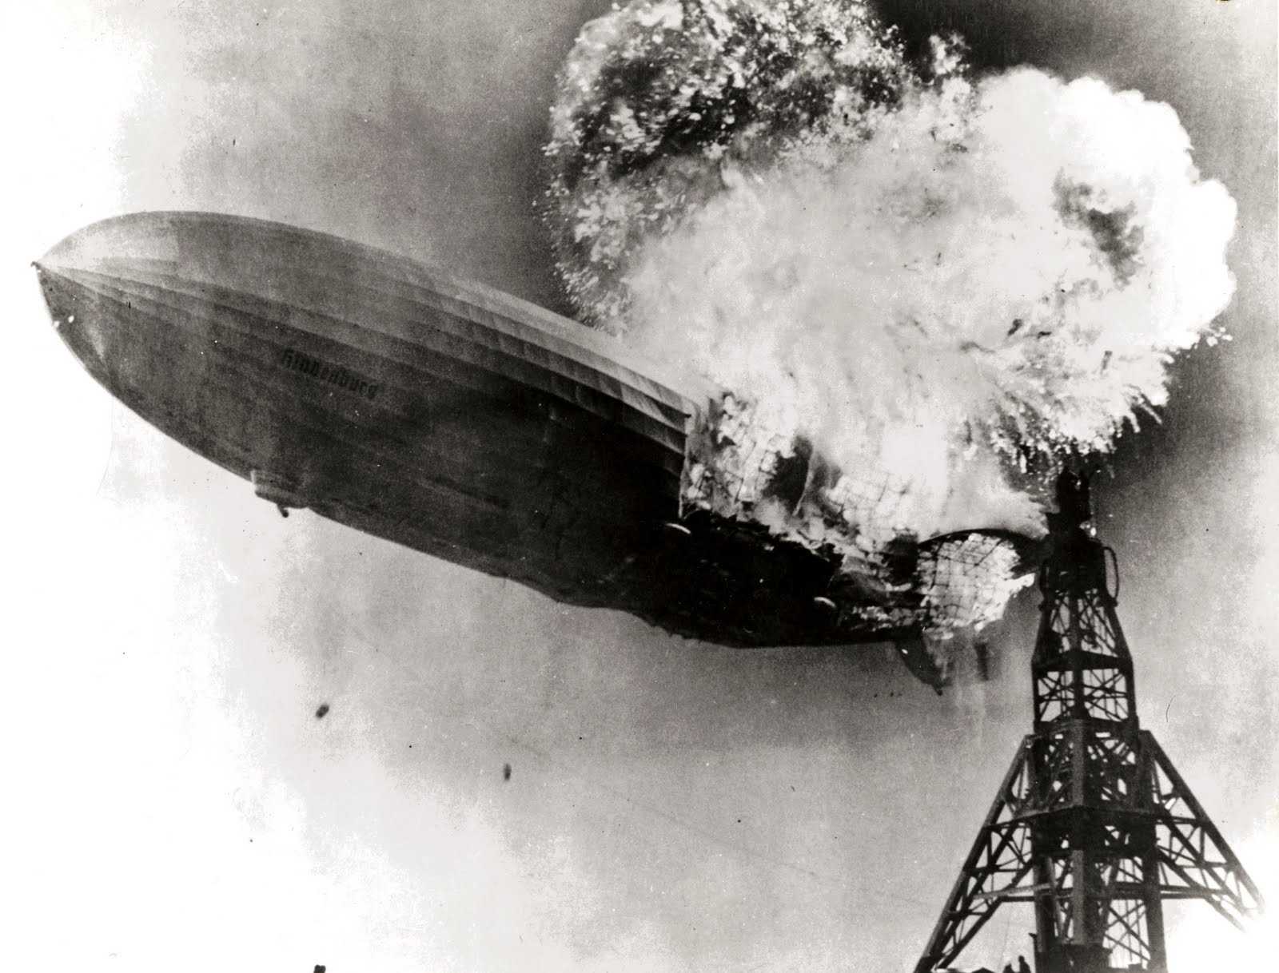

Slide 72
Questions
?

